Slide 1
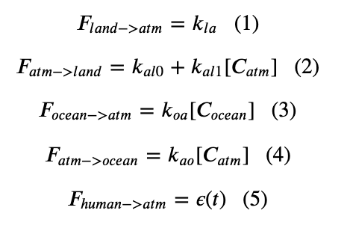
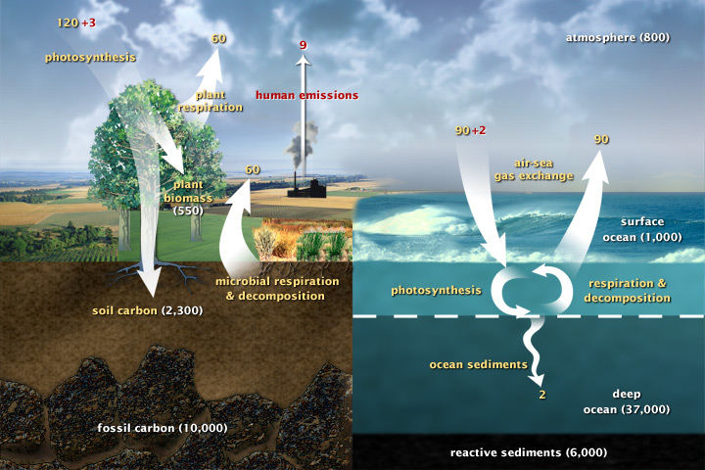
Week 11 - Cambio 3.0 and 4.0

Slide 2
The kind of question I might ask
Which equation(s) change to turn this into Cambio 2.0? 3.0? 4.0?

Slide 3
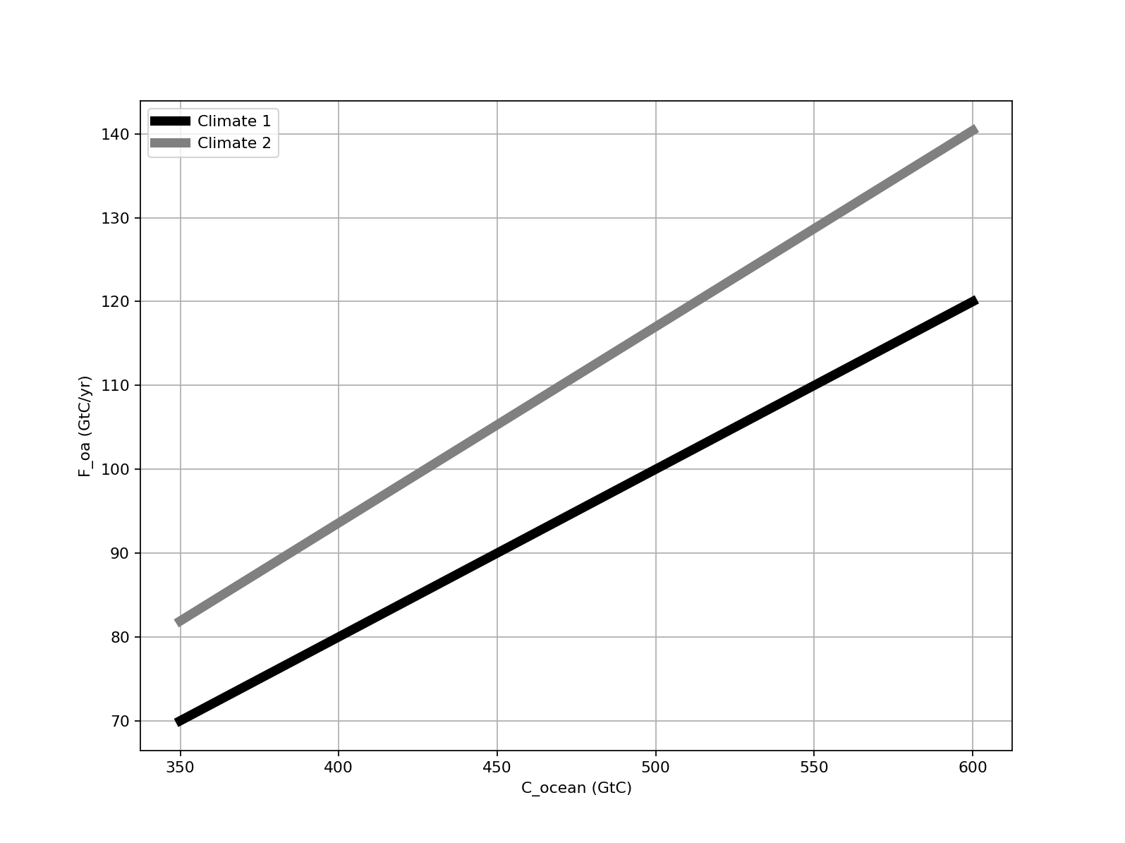
Week 11 - Temperature-dependent ocean feedback (Cambio 3.0)
The curves below represent carbon flux from the ocean to the atmosphere as a function of ocean carbon, at two planetary temperatures.
↑
F_ao
C_ocean

Slide 4
The kind of question I might ask
The curves below represent carbon flux from the ocean to the atmosphere as a function of ocean carbon, at two planetary temperatures.
↑
F_ao
Which line represents the behavior of a warmer ocean (and why)?
C_ocean

Slide 5
The kind of question I might ask
The curves below represent carbon flux from the ocean to the atmosphere as a function of ocean carbon, at two planetary temperatures.
↑
F_ao
Warmer climate
Cooler climate
Is this feedback good news or bad news, from a climate perspective?
C_ocean

Slide 6
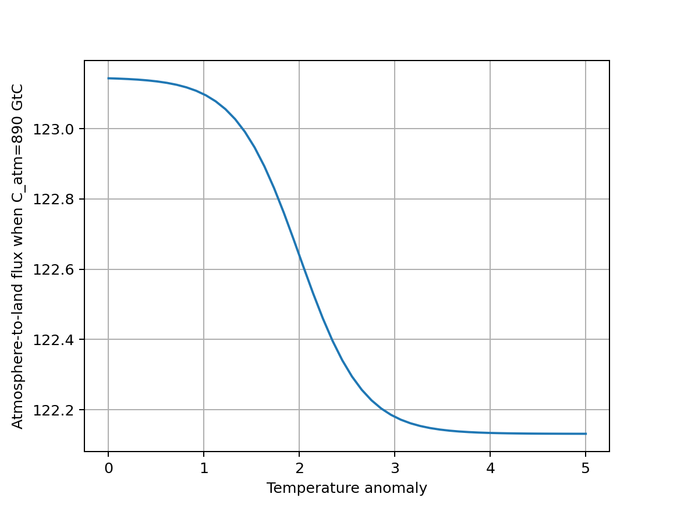
Week 11 - Temperature-dependent atmosphere-to-land feedback (Cambio 4.0)
The curve below represents carbon flux from the atmosphere to the land as a function of the global temperature anomaly when there’s no feedback (dashed line), and when there is feedback (solid line).
↑
F_al

Slide 7
The kind of question I might ask
The curve below represents carbon flux from the atmosphere to the land as a function of the global temperature anomaly when there’s no feedback (dashed line), and when there is feedback (solid line).
↑
F_al
The physical reason behind this reduction is:
We expect more photosynthesis on a warmer planet.
We expect less photosynthesis on a warmer planet.

Slide 8
The kind of question I might ask
The curve below represents carbon flux from the atmosphere to the land as a function of the global temperature anomaly when there’s no feedback (dashed line), and when there is feedback (solid line).
↑
F_al
Is this feedback mechanism good news or bad news, from a climate perspective?

Slide 9
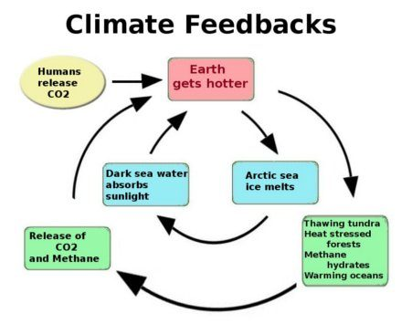
Week 11 – Summary of algorithmic representation of feedbacks
Flux of CO₂ from water to air goes up
Concentration CO₂ in the atmosphere goes up
Level 3
Level 2
Level 1

Slide 10
The kind of question I might ask
Flux of CO₂ from water to air goes up
Concentration CO₂ in the atmosphere goes up
Level 3
Level 2
Level 1
Which Cambio version (1-4) implements which feedback?

Slide 11
The kind of question I might ask
Flux of CO₂ from water to air goes up
Concentration CO₂ in the atmosphere goes up
Level 3
Level 2
Level 1
What name do we associate with the red-colored feedback?

Slide 12
The kind of question I might ask
Flux of CO₂ from water to air goes up
Concentration CO₂ in the atmosphere goes up
Level 3
Level 2
Level 1
Which feedback(s) are characterized by a tipping point (i.e., are sigmoidal)?
Which feedback(s) are not characterized by a tipping point (i.e., are not sigmoidal)?

Slide 13

Week 12 – Models of change
The abolition movement as a model for social change

Slide 14
Political Process Model of (Successful) Social Movements
Week 12 – A sociologist’s (Richard Anderson-Connolly) perspective on social movements
In the sociological literature (see the article by Aldon Morris) there are three elements in social movements’ ability to successfully bring about social change.

Slide 15
Political Process Model of (Successful) Social Movements
The kind of question I might ask
In the sociological literature (see the article by Aldon Morris) there are three elements in social movements’ ability to successfully bring about social change.
Describe the three elements

Slide 16
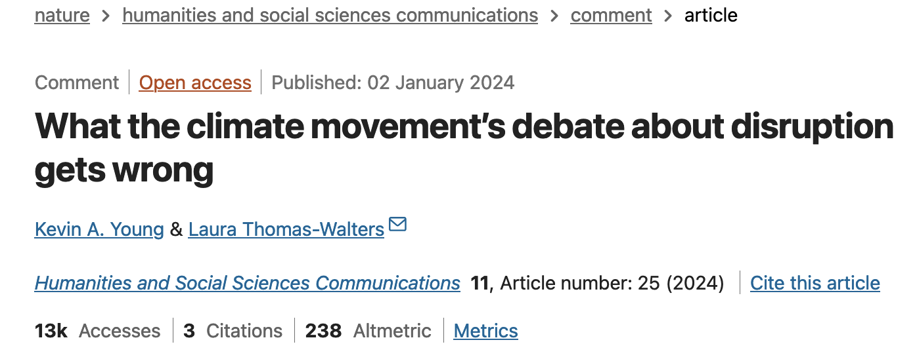
Week 12 – Models of change

Slide 17
The kind of question I might ask
What does the climate movement’s debate get wrong?

Slide 18
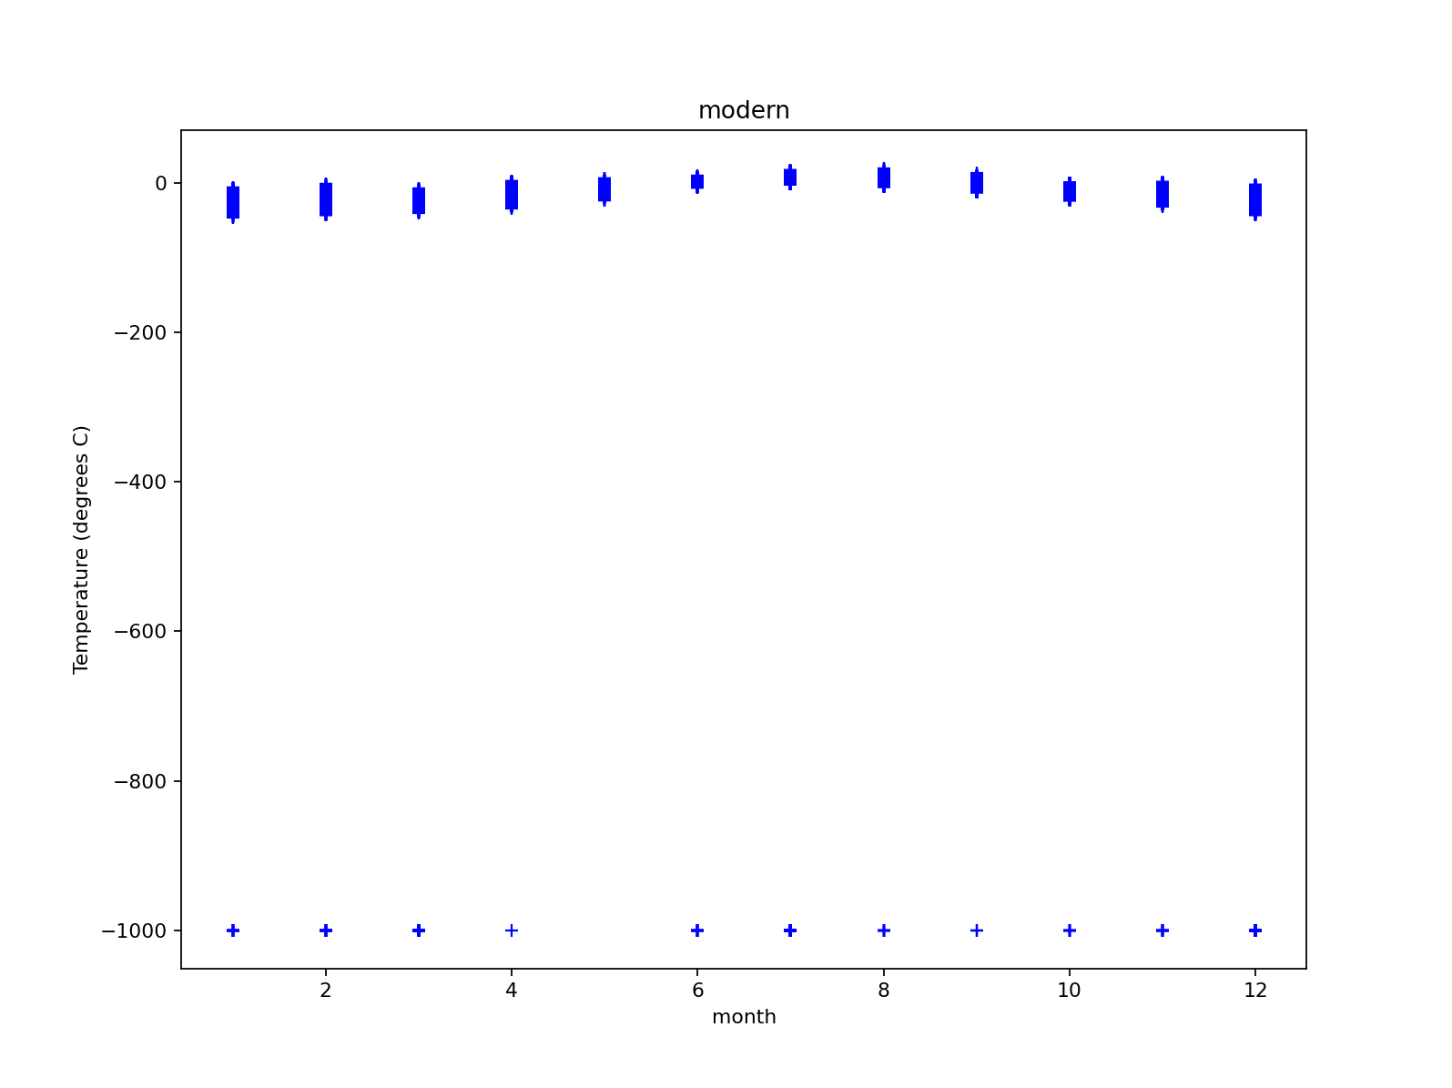
Week 13 – Climate statistics – time series
These data were extracted from the NOAA BRW data archive.
Temperature
month

Slide 19
The kind of question I might ask
These data were extracted from the NOAA BRW data archive.
What’s going on here?
Temperature
month

Slide 20
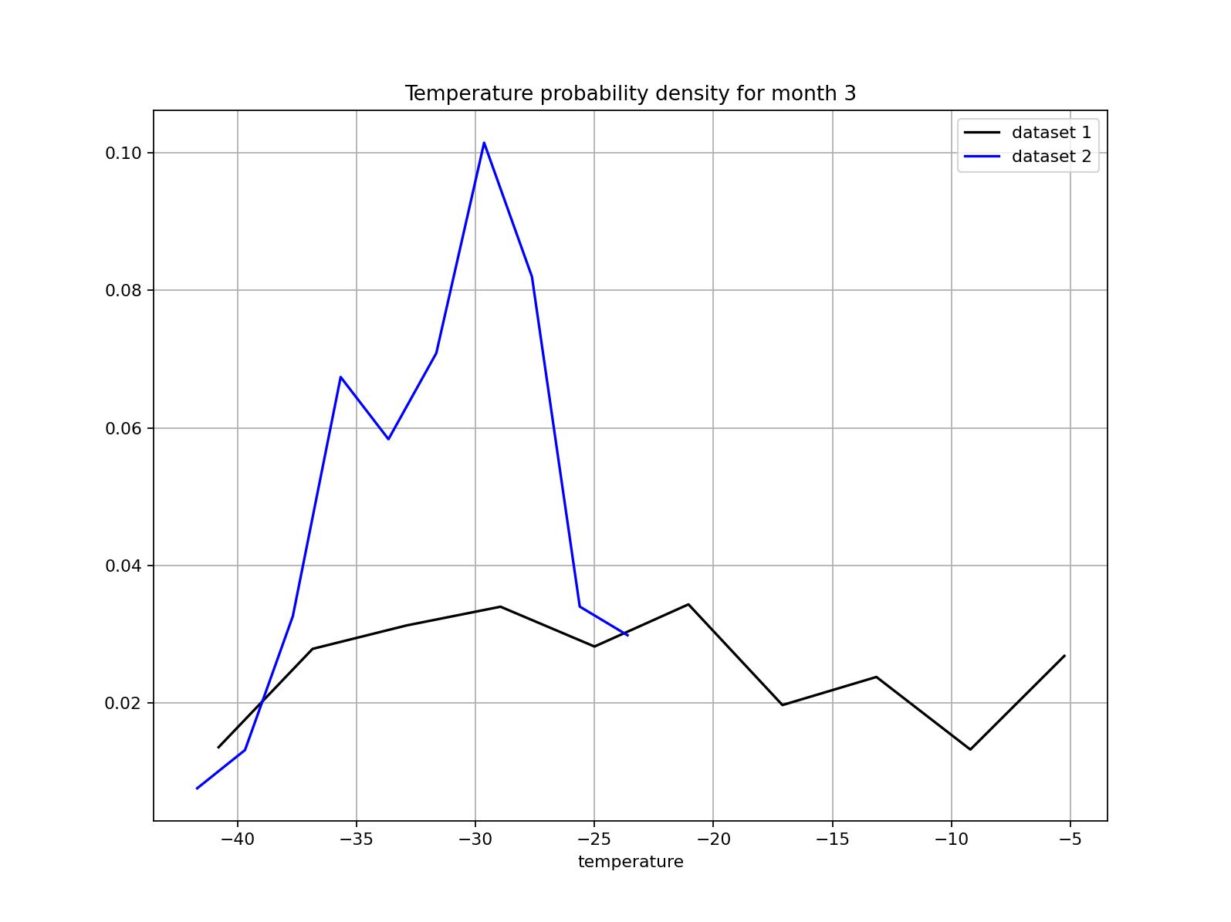
Week 13 – Climate statistics – probability densities
These graphs are based on data from the NOAA BRW data archive, for two different years.
Temperature

Slide 21
The kind of question I might ask
These graphs are based on data from the NOAA BRW data archive, for two different years.
Which dataset seems to indicate greater temperature variability?
Which seems to indicate a warmer climate?
What key limitation to these inferences is a climatologist most likely to point out?
Temperature

Slide 22
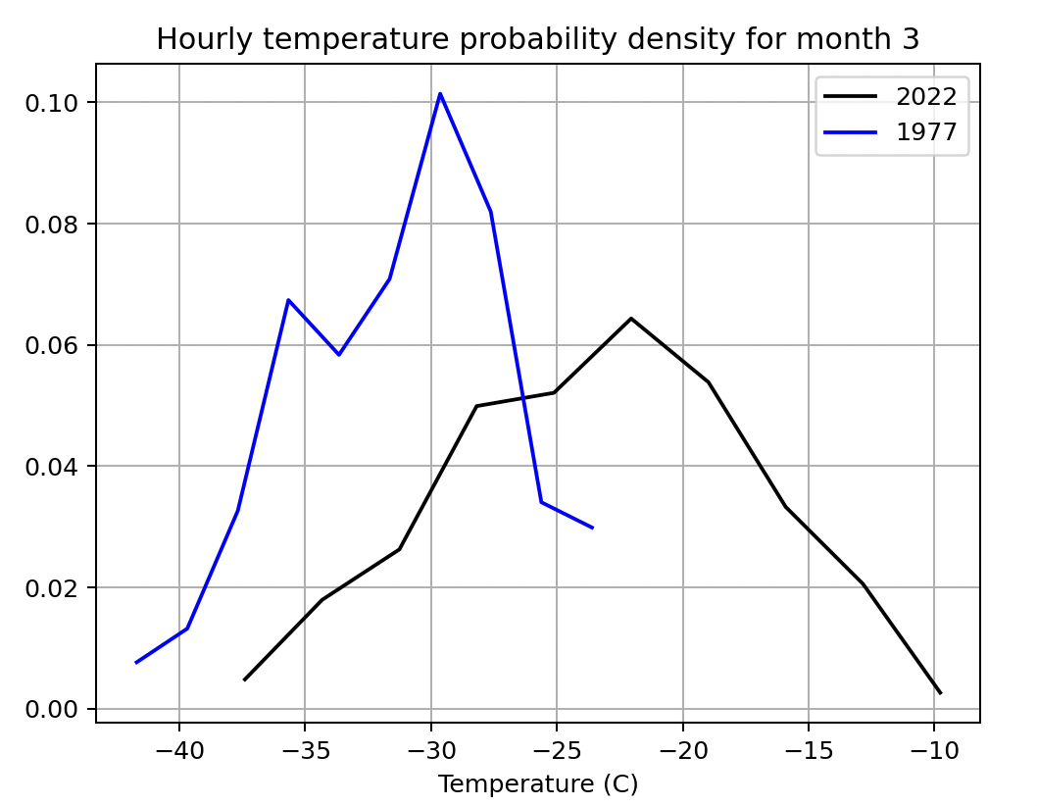
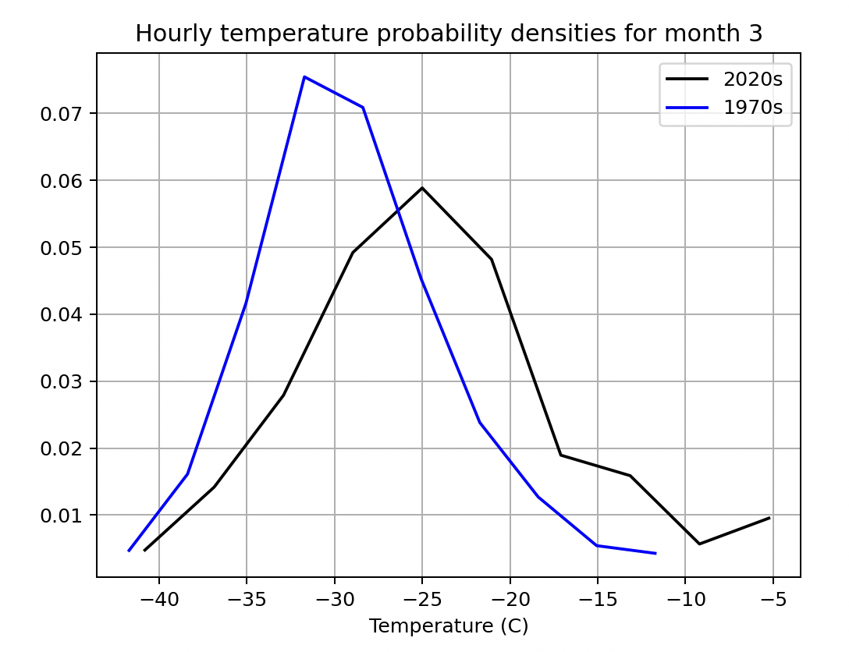

The kind of question I might ask
Which would guess has more years averaged (and why)?

